Slide 1

CLASS 2 CD-404 INTRODUCTION TO DATA SCIENCE UNIT I
WHAT IS DATA SCIENCE ?
Prof. Vineeta Shrivastava
Assistant Professor
Department of Computer Science & Engineering
LNCT-E, Bhopal
Lakshmi Narain College of Technology Excellence, Bhopal

Slide 2
CLASS 2 CD-404 INTRODUCTION TO DATA SCIENCE UNIT I
AGENDA
What is Data Science?
Need of DS
Data Scientists
What do Data Scientists do?
Skills to become a Data Scientist.
Prof. Vineeta Shrivastava
Assistant Professor
Department of Computer Science & Engineering
LNCT-E, Bhopal
Lakshmi Narain College of Technology Excellence, Bhopal

Slide 3
CLASS 2 CD-404 INTRODUCTION TO DATA SCIENCE UNIT I
What is Data Science ?
Data Science is most revolutionary technology of the Era. It’s all about deriving hidden insights from the data in order to solve real world complex Problems.
Data science is one of the most trending and end demanding technologies right now.
Data science is an interdisciplinary field that uses scientific methods, processes, algorithms, and systems to extract insights and knowledge from structured and unstructured data.
It combines expertise from various domains such as statistics, computer science, mathematics, and domain-specific knowledge to analyse and interpret complex data sets.
Prof. Vineeta Shrivastava
Assistant Professor
Department of Computer Science & Engineering
LNCT-E, Bhopal
Lakshmi Narain College of Technology Excellence, Bhopal

Slide 4
CLASS 2 CD-404 INTRODUCTION TO DATA SCIENCE UNIT I
The Process of data science include:
Data Collection: Gathering relevant data from various sources, which can be structured (organized in a tabular format) or unstructured (text, images, videos)
Data Cleaning and Preprocessing: Cleaning and organizing the data to remove errors, missing values, and inconsistencies. This step is crucial for ensuring the quality and reliability of the analysis.
Prof. Vineeta Shrivastava
Assistant Professor
Department of Computer Science & Engineering
LNCT-E, Bhopal
Lakshmi Narain College of Technology Excellence, Bhopal

Slide 5
CLASS 2 CD-404 INTRODUCTION TO DATA SCIENCE UNIT I
Exploratory Data Analysis (EDA): Exploring and summarizing the main characteristics of the data using statistical and visualization techniques to gain a better understanding of its patterns and trends.
Feature Engineering: Creating new features or transforming existing ones to improve the performance of machine learning models.
Model Building and Machine Learning: Applying various machine learning algorithms to build predictive models or uncover patterns and relationships within the data.
Prof. Vineeta Shrivastava
Assistant Professor
Department of Computer Science & Engineering
LNCT-E, Bhopal
Lakshmi Narain College of Technology Excellence, Bhopal

Slide 6
CLASS 2 CD-404 INTRODUCTION TO DATA SCIENCE UNIT I
Model Evaluation and Validation: Assessing the performance of the models using appropriate metrics and ensuring their reliability on new, unseen data.
Interpretation and Visualization: Communicating the results of the analysis to non-technical stakeholders through visualizations and reports, and deriving actionable insights.
Data science is widely used in various industries, including finance, healthcare, marketing, and technology, to inform decision-making processes, predict future trends, and gain a competitive edge.
It involves a combination of technical skills, domain knowledge, and critical thinking to extract meaningful information from data
Prof. Vineeta Shrivastava
Assistant Professor
Department of Computer Science & Engineering
LNCT-E, Bhopal
Lakshmi Narain College of Technology Excellence, Bhopal

Slide 7
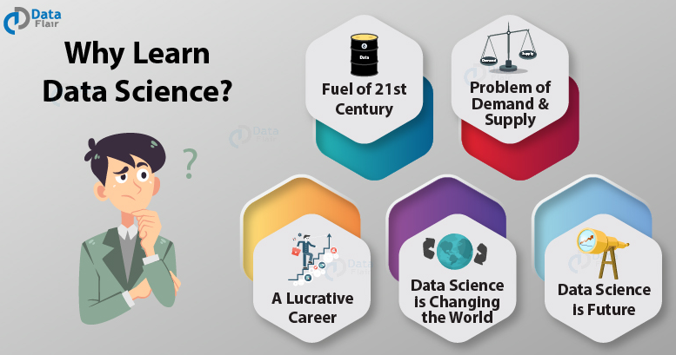
CLASS 2 CD-404 INTRODUCTION TO DATA SCIENCE UNIT I
Need of Data Science The need for data science arises from the increasing volume, variety, and complexity of data generated in today's digital world.
Handling Big Data
Informed Decision-Making
Predictive Analytics
Efficiency and Automation
Risk Management
Healthcare Improvements
Optimizing Processes
Prof. Vineeta Shrivastava
Assistant Professor
Department of Computer Science & Engineering
LNCT-E, Bhopal
Lakshmi Narain College of Technology Excellence, Bhopal

Slide 8
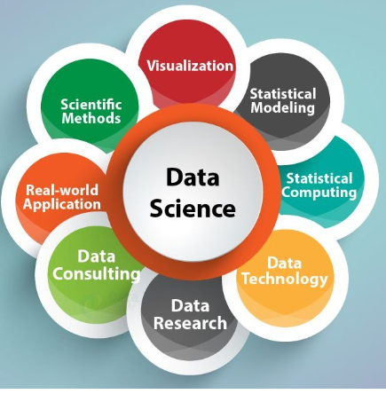
CLASS 2 CD-404 INTRODUCTION TO DATA SCIENCE UNIT I
Need of Data Science
Fraud Detection and Security
Customer Segmentation
Continuous Improvement
Scientific Research
Economic Growth
Adapting to Change
Prof. Vineeta Shrivastava
Assistant Professor
Department of Computer Science & Engineering
LNCT-E, Bhopal
Lakshmi Narain College of Technology Excellence, Bhopal

Slide 9
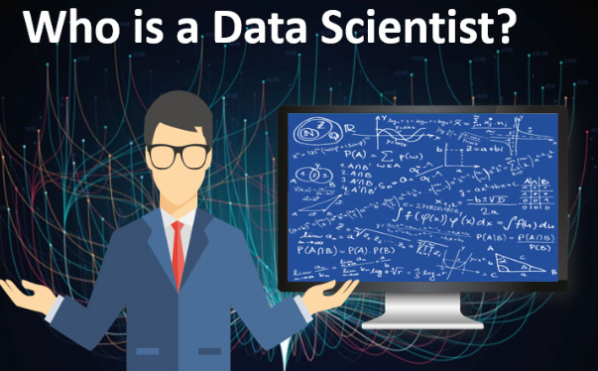
CLASS 2 CD-404 INTRODUCTION TO DATA SCIENCE UNIT I
Data Scientists
A data scientist is an analytics professional who is responsible for collecting, analyzing and interpreting data to help drive decision-making in an organization.
Prof. Vineeta Shrivastava
Assistant Professor
Department of Computer Science & Engineering
LNCT-E, Bhopal
Lakshmi Narain College of Technology Excellence, Bhopal

Slide 10
CLASS 2 CD-404 INTRODUCTION TO DATA SCIENCE UNIT I
Data Scientists
A data scientist is a professional who uses a combination of skills in statistics, mathematics, programming, and domain-specific knowledge to analyze and interpret complex data sets.
The role of a data scientist involves extracting meaningful insights and knowledge from data, helping organizations make informed decisions and solve complex problems.
Prof. Vineeta Shrivastava
Assistant Professor
Department of Computer Science & Engineering
LNCT-E, Bhopal
Lakshmi Narain College of Technology Excellence, Bhopal

Slide 11
CLASS 2 CD-404 INTRODUCTION TO DATA SCIENCE UNIT I
What does data Scientist do?
Data scientists play a crucial role in extracting meaningful insights and knowledge from large and complex datasets.
Their responsibilities encompass a wide range of tasks, and they typically engage in the following activities:
Prof. Vineeta Shrivastava
Assistant Professor
Department of Computer Science & Engineering
LNCT-E, Bhopal
Lakshmi Narain College of Technology Excellence, Bhopal

Slide 12
CLASS 2 CD-404 INTRODUCTION TO DATA SCIENCE UNIT I
Problem Definition
Data Collection
Data Cleaning and Pre-processing
Exploratory Data Analysis (EDA)
Feature Engineering
Model Building
Prof. Vineeta Shrivastava
Assistant Professor
Department of Computer Science & Engineering
LNCT-E, Bhopal
Lakshmi Narain College of Technology Excellence, Bhopal

Slide 13
CLASS 2 CD-404 INTRODUCTION TO DATA SCIENCE UNIT I
What does data Scientist do?
Model Evaluation and Validation
Interpretation and Insights
Data Visualization
Continuous Learning and Improvement
Deployment and Integration
Monitoring and Maintenance
Prof. Vineeta Shrivastava
Assistant Professor
Department of Computer Science & Engineering
LNCT-E, Bhopal
Lakshmi Narain College of Technology Excellence, Bhopal

Slide 14
CLASS 2 CD-404 INTRODUCTION TO DATA SCIENCE UNIT I
What does data Scientist do?
Overall, data scientists use their expertise to turn raw data into actionable insights, drive decision-making processes, and contribute to the success and innovation of organizations across various industries.
Prof. Vineeta Shrivastava
Assistant Professor
Department of Computer Science & Engineering
LNCT-E, Bhopal
Lakshmi Narain College of Technology Excellence, Bhopal

Slide 15
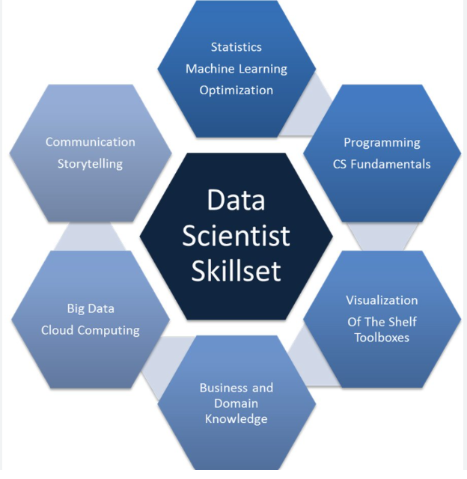
CLASS 2 CD-404 INTRODUCTION TO DATA SCIENCE UNIT I
Data Scientist-Skill Set
Statistics
Programming Language
Data Extraction and processing
Data wrangling and exploration
Machine Learning
Big data processing frameworks
Data visualization
Prof. Vineeta Shrivastava
Assistant Professor
Department of Computer Science & Engineering
LNCT-E, Bhopal
Lakshmi Narain College of Technology Excellence, Bhopal

Slide 16
CLASS 2 CD-404 INTRODUCTION TO DATA SCIENCE UNIT I
Data Science-Skill Set
Data Science is about combining the extraction of Knowledge from data to answer a particular problem allowing business and stakeholders to make intelligent data driven decisions.
Complete technology stack together with soft skills brings more significant challenges to address.
Prof. Vineeta Shrivastava
Assistant Professor
Department of Computer Science & Engineering
LNCT-E, Bhopal
Lakshmi Narain College of Technology Excellence, Bhopal

Slide 17
CLASS 2 CD-404 INTRODUCTION TO DATA SCIENCE UNIT I
Data Scientist
Designing and development of new processes for data modelling and production using prototypes, algorithms ,predictive models and custom analysis.
Prof. Vineeta Shrivastava
Assistant Professor
Department of Computer Science & Engineering
LNCT-E, Bhopal
Lakshmi Narain College of Technology Excellence, Bhopal

Slide 18
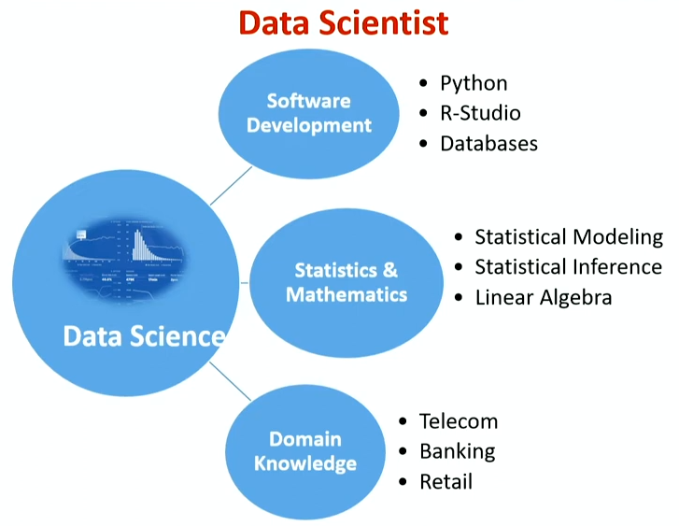
CLASS 2 CD-404 INTRODUCTION TO DATA SCIENCE UNIT I
Data Science-Skill Set
Prof. Vineeta Shrivastava
Assistant Professor
Department of Computer Science & Engineering
LNCT-E, Bhopal
Lakshmi Narain College of Technology Excellence, Bhopal

Slide 19
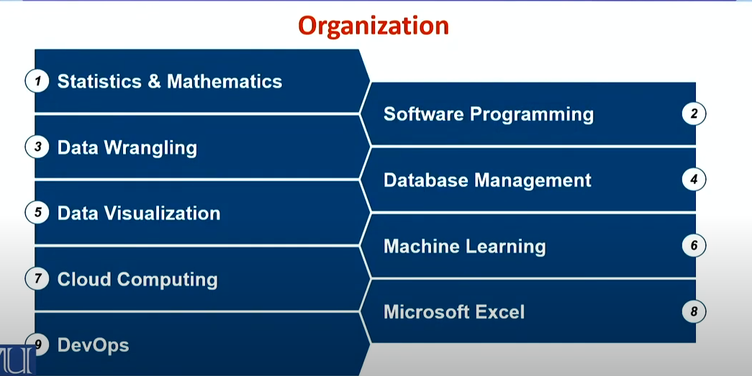
CLASS 2 CD-404 INTRODUCTION TO DATA SCIENCE UNIT I
Organization-Skill Set
Prof. Vineeta Shrivastava
Assistant Professor
Department of Computer Science & Engineering
LNCT-E, Bhopal
Lakshmi Narain College of Technology Excellence, Bhopal

Slide 20
CLASS 2 CD-404 INTRODUCTION TO DATA SCIENCE UNIT I
Data Growth Challenges
Data Around us is growing at an exponential rate.
Till 2026,global data creation is projected to grow to more than 180 zettabytes.
Just two percent of the data produces and consumed in 2020 was saved and retained into 2021.
Installed storage capacity is growing at CAGR(compound annual growth rate) of 19.2 till 2026
Prof. Vineeta Shrivastava
Assistant Professor
Department of Computer Science & Engineering
LNCT-E, Bhopal
Lakshmi Narain College of Technology Excellence, Bhopal

Slide 21
CLASS 2 CD-404 INTRODUCTION TO DATA SCIENCE UNIT I
Infrastructure Improvement Drive:
Enterprises are evaluating & implementing infrastructure capacity to cope up with exponential data growth and gain operational maturity in a cost effective manner.
Prof. Vineeta Shrivastava
Assistant Professor
Department of Computer Science & Engineering
LNCT-E, Bhopal
Lakshmi Narain College of Technology Excellence, Bhopal

Slide 22
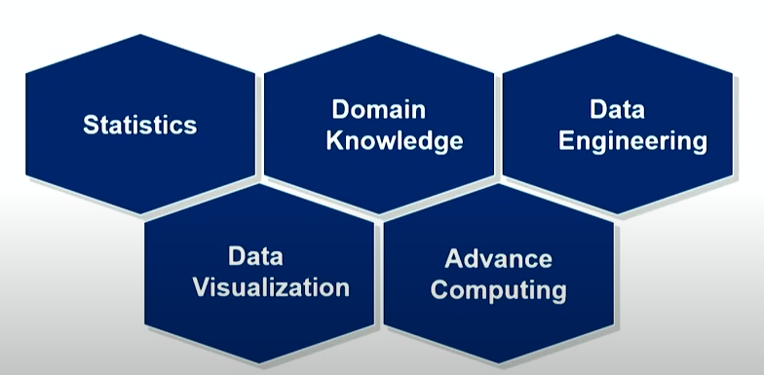
CLASS 2 CD-404 INTRODUCTION TO DATA SCIENCE UNIT I
Expertise
Prof. Vineeta Shrivastava
Assistant Professor
Department of Computer Science & Engineering
LNCT-E, Bhopal
Lakshmi Narain College of Technology Excellence, Bhopal

Slide 23
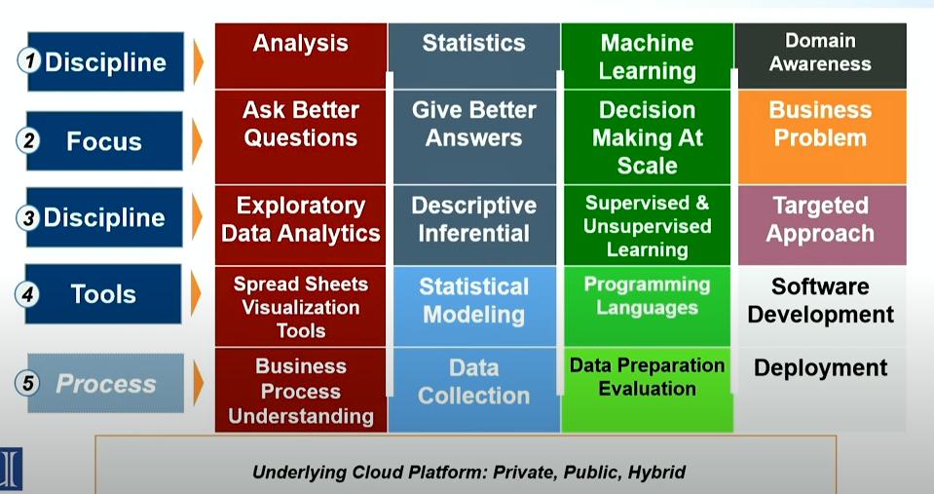
CLASS 2 CD-404 INTRODUCTION TO DATA SCIENCE UNIT I
Current Landscape
Prof. Vineeta Shrivastava
Assistant Professor
Department of Computer Science & Engineering
LNCT-E, Bhopal
Lakshmi Narain College of Technology Excellence, Bhopal

Slide 24
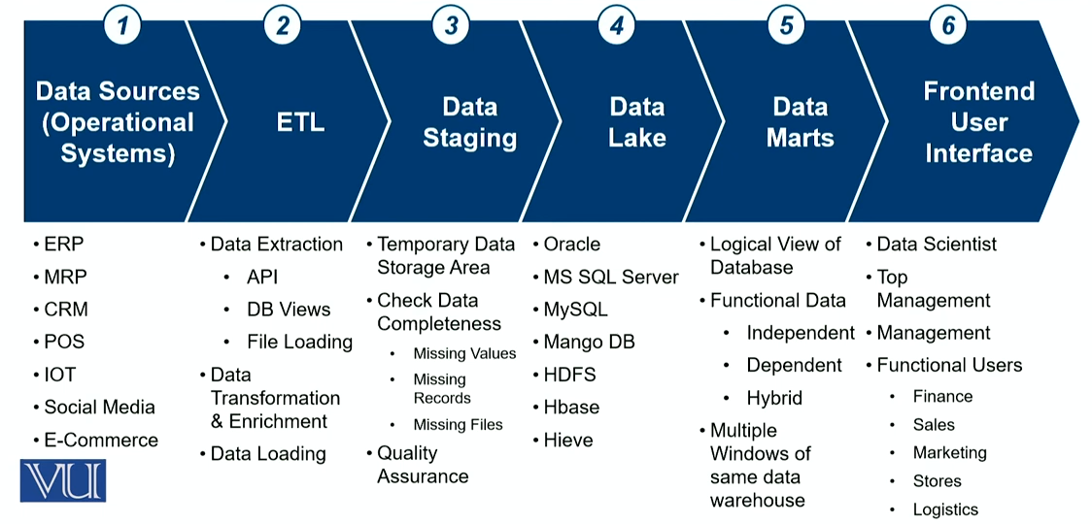
CLASS 2 CD-404 INTRODUCTION TO DATA SCIENCE UNIT I
Software Development
Prof. Vineeta Shrivastava
Assistant Professor
Department of Computer Science & Engineering
LNCT-E, Bhopal
Lakshmi Narain College of Technology Excellence, Bhopal

Slide 25
CLASS 2 CD-404 INTRODUCTION TO DATA SCIENCE UNIT I
Object Oriented Programming
Object oriented Programming has an important place in programming skills required for data scientists.
Programming languages like Python and Java comply with major OOP principles yet, data scientists need to understand the concepts such as objects , attributes, methods and inheritance) to work in real-world software projects.
Prof. Vineeta Shrivastava
Assistant Professor
Department of Computer Science & Engineering
LNCT-E, Bhopal
Lakshmi Narain College of Technology Excellence, Bhopal

Slide 26
CLASS 2 CD-404 INTRODUCTION TO DATA SCIENCE UNIT I
Full Stack Developer
Data Scientists need to deliver more than machine learning modules in the backend to put the machine learning and data analytics to codes into production following are few examples:
Programming Languages
Integration Services (Windows, XML, JSON)
Big data-Hadoop , Mongo DB
DevOps-Jenkins , Dockers.
Prof. Vineeta Shrivastava
Assistant Professor
Department of Computer Science & Engineering
LNCT-E, Bhopal
Lakshmi Narain College of Technology Excellence, Bhopal

Slide 27
CLASS 2 CD-404 INTRODUCTION TO DATA SCIENCE UNIT I
Programming Language
Data Science has multiple fields but software Engineering is the most important skill in data science.
Following are the most popular data science programming languages:
Python
R
Java
C++
Scala
Prof. Vineeta Shrivastava
Assistant Professor
Department of Computer Science & Engineering
LNCT-E, Bhopal
Lakshmi Narain College of Technology Excellence, Bhopal

Slide 28
CLASS 2 CD-404 INTRODUCTION TO DATA SCIENCE UNIT I
Data Bases SQL & NoSQL
Data Scientist need to analyse massive data sets and often require SQL and NoSQL tools & techniques.
SQL Query Language
Hieve
BASE
SPARK
Prof. Vineeta Shrivastava
Assistant Professor
Department of Computer Science & Engineering
LNCT-E, Bhopal
Lakshmi Narain College of Technology Excellence, Bhopal

Slide 29
CLASS 2 CD-404 INTRODUCTION TO DATA SCIENCE UNIT I
THANKYOU
Prof. Vineeta Shrivastava
Assistant Professor
Department of Computer Science & Engineering
LNCT-E, Bhopal
Lakshmi Narain College of Technology Excellence, Bhopal

Slide 30
CLASS 2 CD-404 INTRODUCTION TO DATA SCIENCE UNIT I
Need of Data Science
Handling Big Data: The sheer volume of data generated daily is massive. Data science provides the tools and techniques to analyze and derive meaningful insights from big data, which traditional methods may struggle to handle.
Informed Decision-Making:
Businesses and organizations can make more informed decisions by relying on data-driven insights. Data science helps in uncovering patterns and trends that guide strategic choices.
Predictive Analytics:
Data science enables organizations to predict future trends, customer behaviors, and market changes. This predictive power allows for proactive decision-making and strategic planning.
Efficiency and Automation:
Data science automates repetitive tasks and streamlines processes, improving operational efficiency. This efficiency gains from automation free up time for more strategic tasks.
Risk Management:
In finance, healthcare, and other sectors, data science helps identify and mitigate risks. It provides tools for fraud detection, credit scoring, and risk assessment.
Healthcare Improvements:
Data science contributes to advancements in healthcare, such as personalized medicine, predictive analytics for disease outbreaks, and the optimization of treatment plans based on patient data.
optimizing Processes:
Data science identifies inefficiencies and areas for improvement in processes. This optimization leads to cost savings and improved overall performance.
Fraud Detection and Security:
Data science is crucial for identifying patterns associated with fraudulent activities, enhancing security measures in financial transactions, online interactions, and various other domains.
Customer Segmentation:
Businesses use data science to segment their customer base and tailor marketing strategies to specific groups, resulting in more effective and targeted campaigns.
Continuous Improvement:
Through ongoing analysis, data science facilitates continuous improvement by providing feedback on processes, products, and services.
Scientific Research:
In fields such as physics, biology, and astronomy, data science helps analyze large datasets, discover patterns, and draw conclusions that contribute to scientific knowledge.
Economic Growth:
The growth of data science contributes to economic development by fostering innovation, creating new business opportunities, and improving efficiency across industries.
Adapting to Change:
In a rapidly changing world, data science helps organizations adapt by providing insights into evolving market conditions, consumer preferences, and industry trends.
Prof. Vineeta Shrivastava
Assistant Professor
Department of Computer Science & Engineering
LNCT-E, Bhopal
Lakshmi Narain College of Technology Excellence, Bhopal

Slide 31
CLASS 2 CD-404 INTRODUCTION TO DATA SCIENCE UNIT I
What does data scientist do?
Problem Definition:
Collaborate with stakeholders to understand business problems and define clear objectives that can be addressed using data.
Data Collection:
Gather relevant data from various sources, including databases, APIs, and external datasets, ensuring it covers the necessary aspects of the problem at hand.
Data Cleaning and Preprocessing:
Clean and preprocess data to address issues such as missing values, outliers, and inconsistencies. This step is essential for ensuring the quality and reliability of the data.
Exploratory Data Analysis (EDA):
Conduct exploratory data analysis to understand the main characteristics of the data, identify patterns, and uncover initial insights. This often involves creating visualizations and summary statistics.
Feature Engineering:
Create new features or transform existing ones to improve the performance of machine learning models. Feature engineering involves selecting and preparing the most relevant variables for analysis.
Model Building:
Apply statistical and machine learning techniques to build predictive models or classification systems. Data scientists choose appropriate algorithms based on the nature of the problem and the characteristics of the data.
Model Evaluation and Validation:
Assess the performance of the models using various metrics and validate their accuracy and reliability. This step involves testing models on new, unseen data to ensure they generalize well.
Interpretation and Insights:
Interpret the results of data analyses and model outputs, deriving actionable insights and recommendations. Communicate findings to both technical and non-technical stakeholders through reports, presentations, or visualizations.
Data Visualization:
Use visualization tools to create charts, graphs, and dashboards that effectively communicate complex information. Visualization helps stakeholders understand the patterns and trends identified in the data.
Continuous Learning and Improvement:
Stay updated on the latest tools, techniques, and advancements in data science. Engage in continuous learning to improve skills and adapt to evolving technologies.
Collaboration:
Collaborate with cross-functional teams, including business analysts, engineers, and domain experts, to align data science efforts with business goals and ensure that solutions meet practical requirements.
Ethical Considerations:
Be mindful of ethical considerations related to data privacy, security, and biases. Strive to develop models that are fair, unbiased, and respectful of privacy concerns.
Deployment and Integration:
Work with software engineers to integrate data science models into operational systems. Ensure that the deployment of models aligns with the organization's infrastructure and requirements.
Monitoring and Maintenance:
Monitor the performance of deployed models and update them as needed. Address issues such as concept drift and changing data patterns that may affect model accuracy over time.
Prof. Vineeta Shrivastava
Assistant Professor
Department of Computer Science & Engineering
LNCT-E, Bhopal
Lakshmi Narain College of Technology Excellence, Bhopal

